Slide 1

E-PROJECT
WOW
WONDERS OF WORLD

Slide 2
FACULTY NAME : MISS NASHMIA KHAN
CORDINATOR NAME : MISS MADIHA FATIMA
BATCH CODE : 2305F1
STUDENTS NAME : (EJLAL AHMED, MUSTAJAB AHMED, SEHRISH)

Slide 3
E-PROJECT DESCRIPTION:
Our project, “Wonders of Word”, aims to provide you with a comprehensive guide to the history and significance of the Seven Wonders of the World . Additionally, we offer a convenient booking platform for your travel , allowing users to plan their visit to these remarkable sites with ease.

Slide 4
OUR SITE-MAP
ABOUT
US
CONTACT
TEAM
HOME
MOST
VISIT
GALLERY
FLIGHT

Slide 5
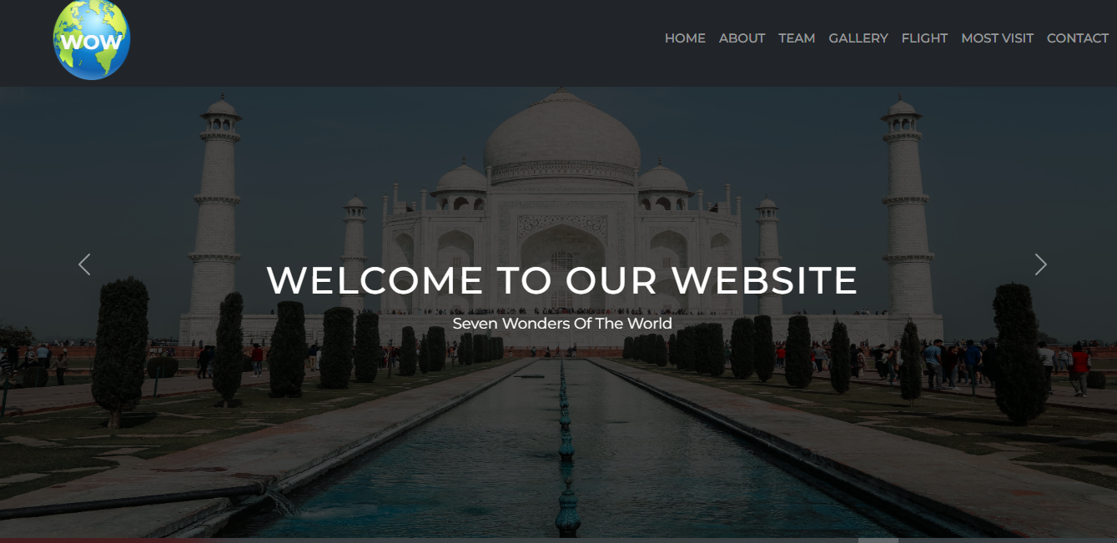
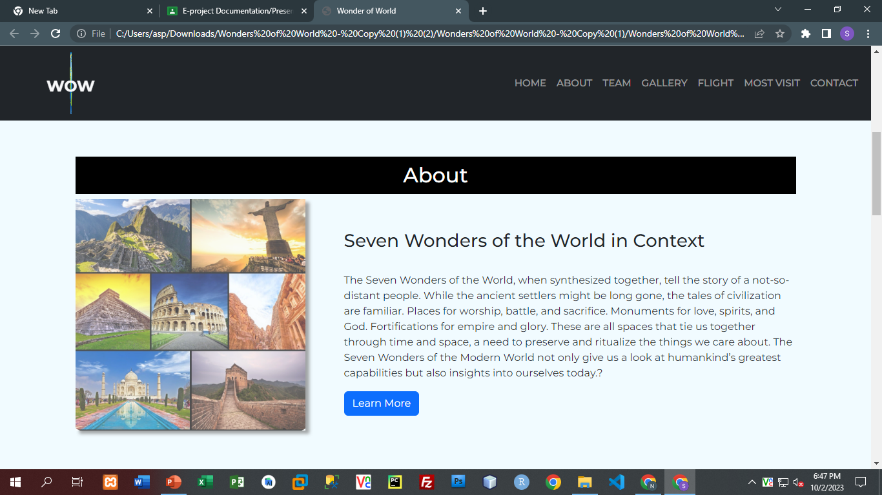
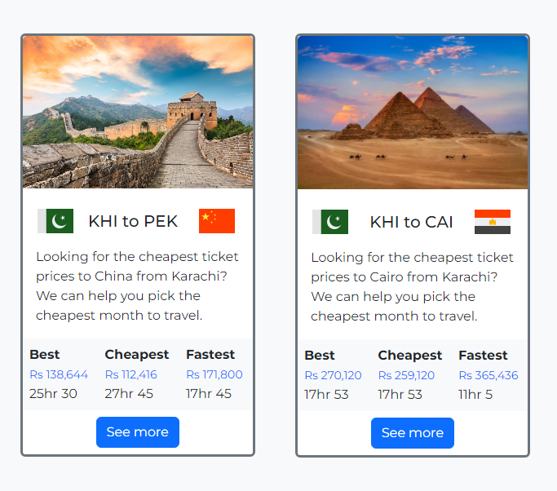
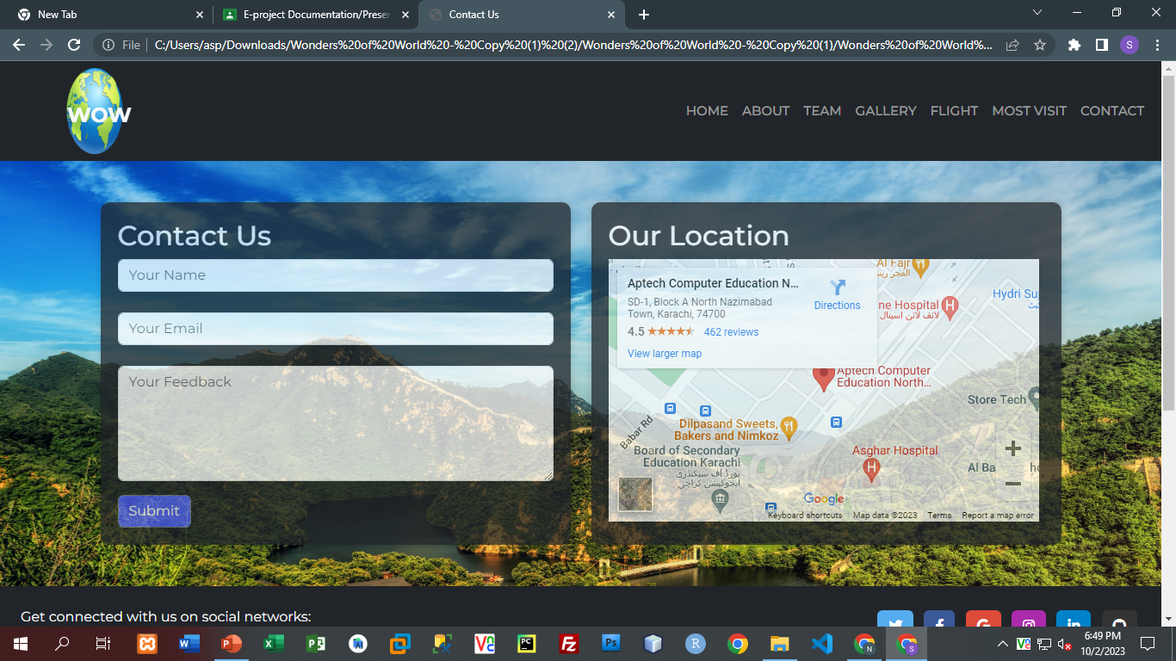
ADMIN CAN PERFORM THESE TASKS FROM ADMIN-END :

Slide 6
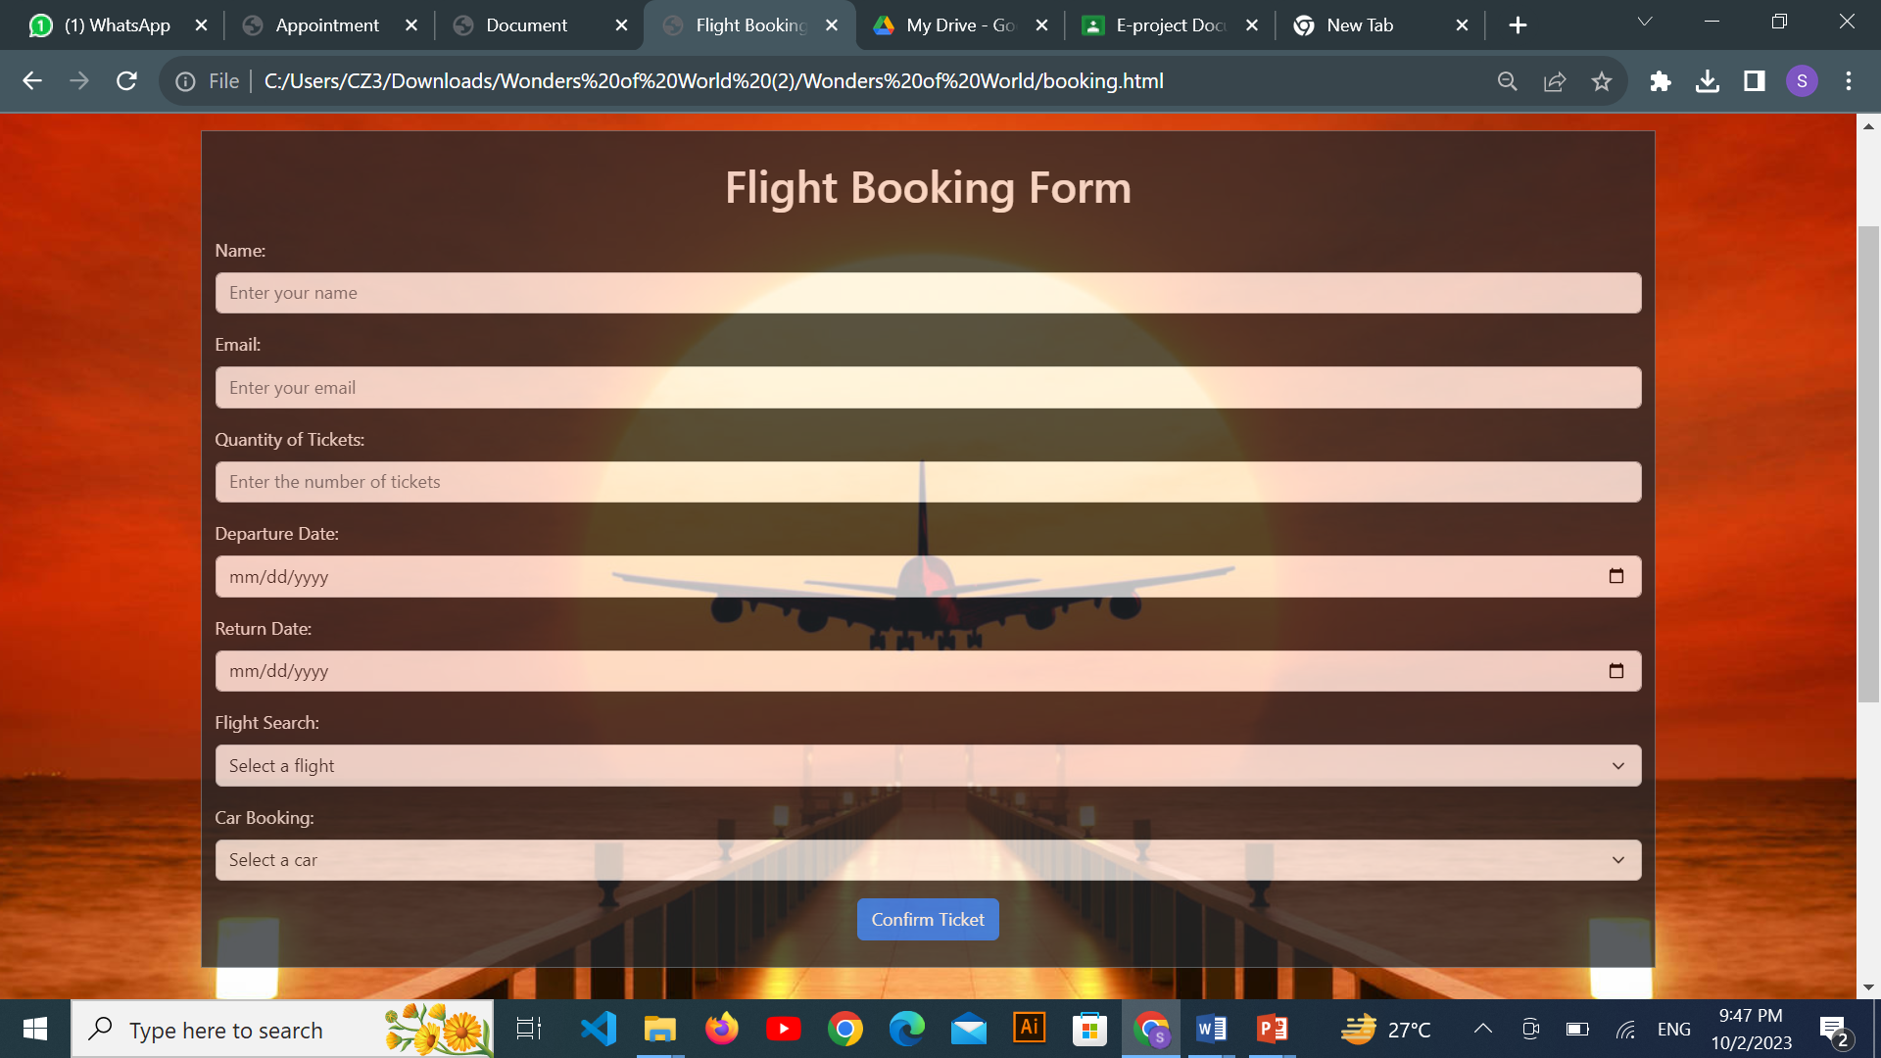
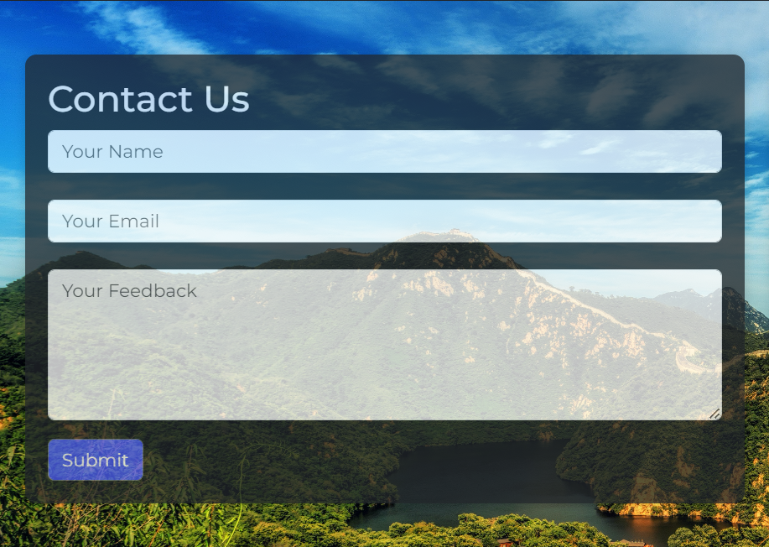
USER ARE ABLE TO DO THESE TASKS:

Slide 7


FUTURE ENHANCEMENT:
In the future, we are looking to enhance our tourist guide services on our website . Our website will offer upgraded features and more interactive tools to provide travelers with even better guidance during their journeys.

Slide 8


